Slide 1

ZAS Robotic Products
Navigational Robotic Series
Robot Car-3 (Advanced Autonomy)
GPS Speed and Direction information

Slide 2
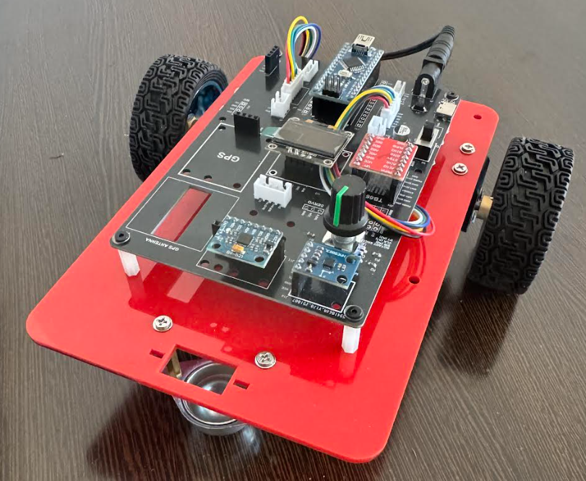
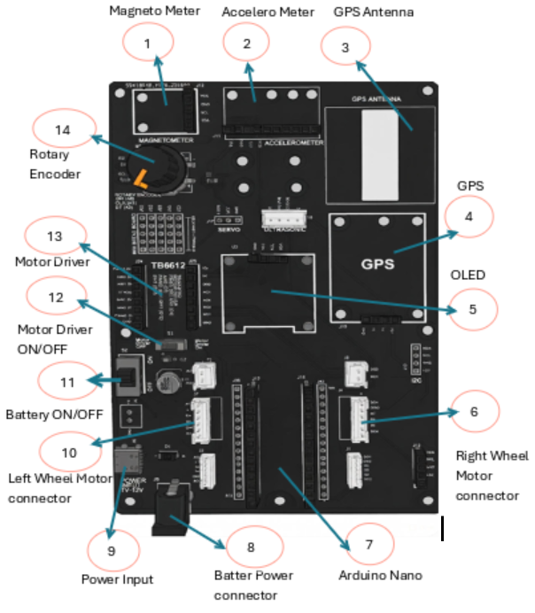
GPS Speed and Direction information
Robot Car-1 - Assembled view and Creative Board component layout

Slide 3
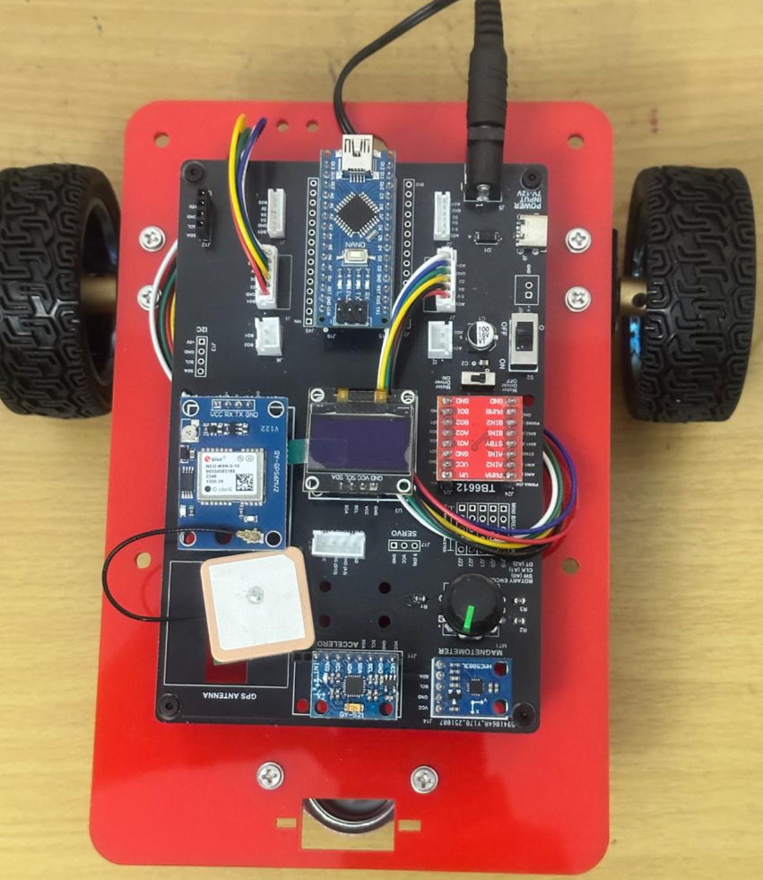
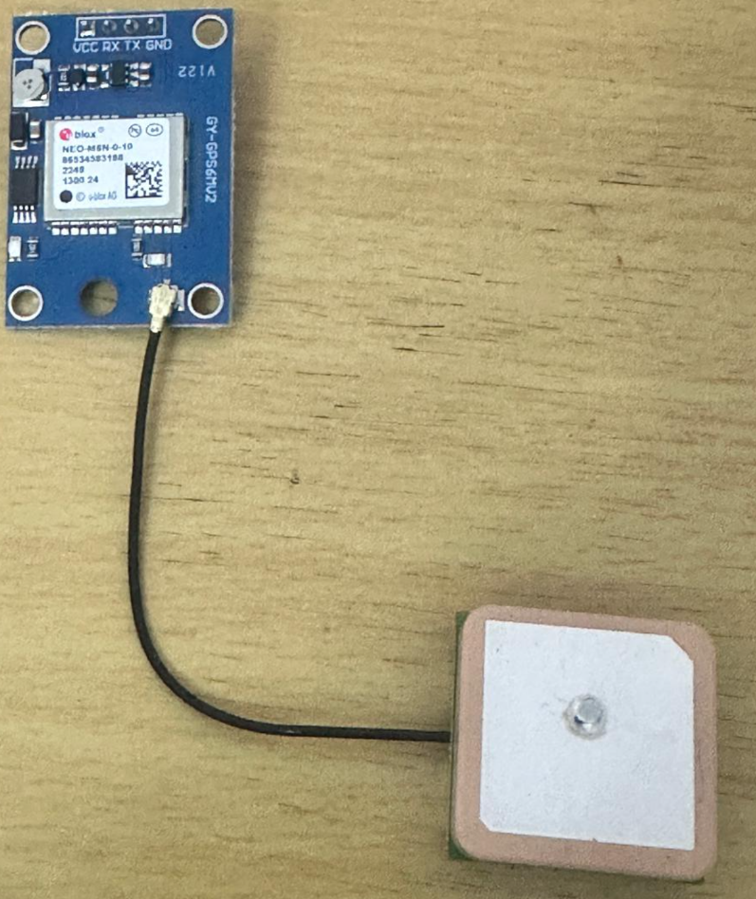
GPS Speed and Direction information
GPS & GPS Antenna mounter on Robot Car-3

Slide 4
GPS Speed and Direction information
Experiment Overview
This experiment demonstrates how GPS data can be used to determine the linear speed and direction of movement of a mobile robotic platform.
The GPS receiver continuously computes motion parameters based on satellite signals and provides real-time speed and course information, which is displayed on an OLED interface.
Objective
The objective of this experiment is to:
Determine whether a valid GPS fix is available
Measure the instantaneous speed of the robot using GPS velocity data
Determine the direction of movement using GPS course information
Identify whether the robot is stationary or in motion based on speed thresholding
Visualize motion parameters clearly on an OLED display

Slide 5
GPS Speed and Direction information
Key GPS Parameters Used
Fix Status Indicates whether the GPS receiver has successfully locked onto satellites
Satellite Count Number of satellites contributing to the current position solution
Speed (km/h) Calculated internally by the GPS module using Doppler shift data
Course / Direction (degrees) Direction of motion relative to geographic North (0°–360°)

Slide 6
GPS Speed and Direction information
Speed Measurement Concept
GPS speed is calculated based on Doppler frequency shift of satellite signals. This method provides:
High accuracy during motion
Reliable speed readings independent of wheel slip
Stable measurements at moderate and higher velocities
Speed values are displayed in kilometers per hour (km/h).

Slide 7
GPS Speed and Direction information
Direction (Course) Concept
The direction of movement represents the bearing of motion, not the compass heading.
0° → North
90° → East
180° → South
270° → West
Course information becomes valid only when the robot is moving.

Slide 8
GPS Speed and Direction information
Program Execution Flow
GPS serial data is continuously read and decoded
OLED is refreshed every 500 ms
GPS fix and satellite count are checked
Speed and direction values are extracted
Motion status is determined using speed threshold
All parameters are displayed on the OLED

Slide 9
GPS Speed and Direction information
OLED Display Parameters
The OLED displays:
GPS Fix status
Number of satellites in use
Current speed in km/h
Direction of movement in degrees
Motion status (YES / NO)
This provides immediate visual feedback during testing.

Slide 10
GPS Speed and Direction information
Testing Conditions
Testing must be performed outdoors
Clear sky view improves satellite lock
Robot must move in a straight path for stable direction readings
Sudden stops may momentarily retain last valid direction
Observations
Speed remains zero when stationary even with GPS fix
Direction becomes valid only after movement begins
Higher satellite count improves measurement stability
Motion detection responds smoothly with thresholding

Slide 11
GPS Speed and Direction information
System Setup
Hardware Used
Arduino Nano (ATmega328P)
GPS Module (UART based)
OLED Display 128×64 (I2C, Address 0x3C)
Robot Car-3 Controller Board
Important Wiring Note
GPS connected to D0 (RX) / D1 (TX)
Disconnect GPS during program upload if required
Do not keep Serial Monitor open during upload
Note:
Cold start time may be 2–5 minutes outdoors.

Slide 12
GPS Speed and Direction information
Algorithm
Initialize serial communication for GPS data reception
Initialize OLED display for visual output
Continuously read incoming GPS serial data
Decode GPS NMEA sentences using TinyGPS++
Check whether a valid GPS fix is available
Read speed information from GPS velocity data
Read direction (course) of movement in degrees
Apply a threshold to determine motion state
Display Fix status, speed, direction, and motion state on OLED
Refresh the display at fixed time intervals
Repeat the process continuously

Slide 13
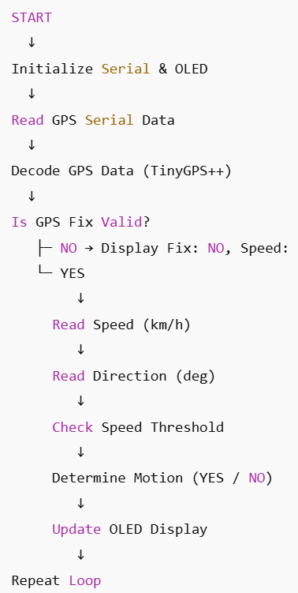
GPS Speed and Direction information
Flow of Operation —
GPS Speed & Direction

Slide 14
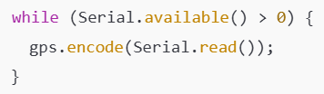
GPS Speed and Direction information
Code Explanation — GPS Data Decoding
GPS data arrives as a continuous serial byte stream
Each byte is passed to the TinyGPS++ decoder
TinyGPS++ internally reconstructs NMEA sentences
Continuous decoding is required to maintain valid speed and direction values

Slide 15
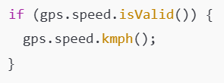
GPS Speed and Direction information
Code Explanation — Speed Calculation
Speed is calculated internally by the GPS receiver
Based on Doppler shift of satellite signals
Independent of wheel rotation or encoders
Provides real-world velocity measurement

Slide 16
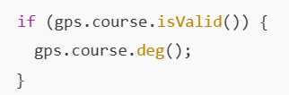
GPS Speed and Direction information
Code Explanation — Direction (Course)
Direction represents course over ground
Measured relative to geographic North
Valid only when the robot is moving
Not a compass heading (different concept)

Slide 17
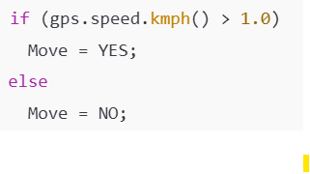
GPS Speed and Direction information
Motion Detection Logic
A threshold is used to avoid noise-based false motion
Speed below threshold is treated as stationary
Simplifies motion-state detection for embedded systems

Slide 18
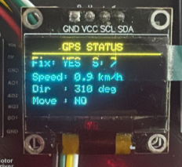
GPS Speed and Direction information
OLED Output Interpretation — GPS Speed & Direction
Displayed Parameters (As Seen on OLED)
OLED Field | Example Value | Meaning | How to Interpret
Fix | YES | GPS position lock acquired | GPS has enough satellite data to compute position
Speed | 0.9 km/h | Ground speed from GPS | Very low speed (learning robot movement)
Dir | 310 deg | Course over ground | Direction of motion relative to North
Move | NO | Motion detection flag | Speed below movement threshold

Slide 19
GPS Speed and Direction information
Learning Value for a Low-Speed Robot
Key Learning Outcomes (Conceptual)
GPS speed is computed using Doppler shift, not wheel rotation
GPS direction represents course of motion, not compass heading
Even at low speeds:
Speed values fluctuate near zero
Direction becomes unstable or invalid when stationary
Students observe real-world GPS limitations, including:
Update delays
Noise at low velocity
Dependency on satellite geometry
What students actually learn (very important)
Why GPS is unsuitable for fine indoor motion
Why GPS must be combined with encoders or IMU for accurate navigation
How professional robots fuse sensors instead of relying on one source
Why thresholds (e.g., > 1.0 km/h) are required to avoid false motion detection

Slide 20
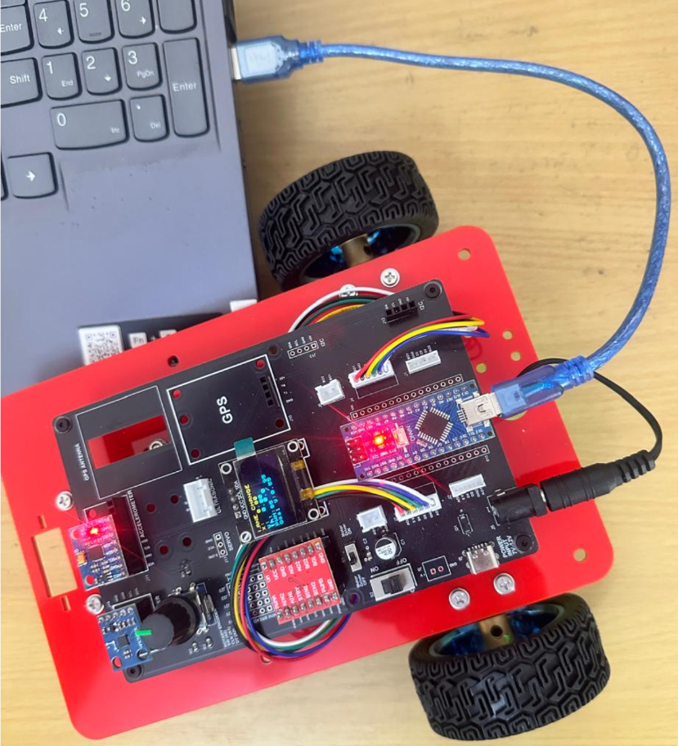
GPS Speed and Direction information
Critical Programming Setup
MANDATORY Switch Settings Before Uploading Code
Before connecting USB and uploading program:
“Motor Driver ON/OFF” Switch
⚠️ MUST BE SET TO: OFF
Why?
Prevents motors from running during code upload
Avoids car moving unexpectedly on desk
Protects USB connection from power surges

Slide 21
GPS Speed and Direction information
During Programming (Code Upload):
Step 1: Connect USB cable to computer
Step 2: Set Switch “Motor Driver ON/OFF” → OFF
Step 3: Set Switch “Battery ON/OFF ” → OFF ->for batter power
Step 4: Upload your the respective program
Step 5: Wait for "Upload Complete" message
Step 6: Disconnect USB cable
Before Testing (Running the Robot):
Step 1: Place robot on the ground. No obstacle as this test for basic movements
Step 2: Set Switch “Motor Driver ON/OFF” ->ON ( motor driver ON)
Step 3: Set Switch “Battery ON/OFF” → ON -> for batter power
Step 4: Monitor the Robot car-3 Movements & OLED , Monitior the functionality according to the program
https://github.com/info-zas/zas-robotics-car-3-encoders-imu-gps/tree/main/01_FoundationProjects/07_Car-3_GPS_Velocity_and_Heading
Lesson Code – GitHub URL:

Slide 22
Q&A
Invite Questions: Encourage the audience to ask questions for further clarification or discussion.

